Slide 1
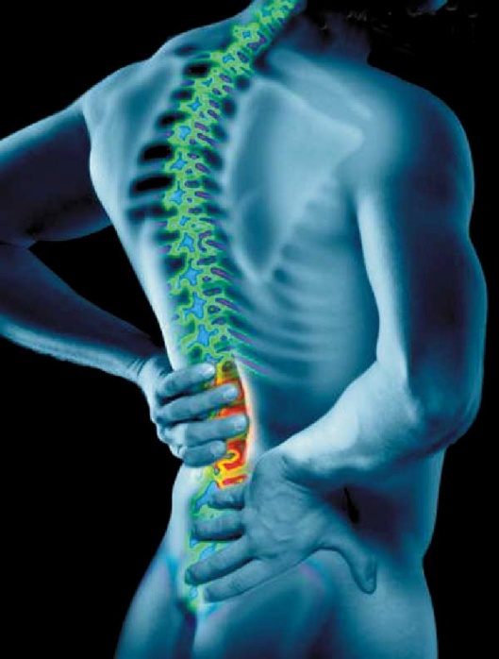
A PSYCHOSOMATIC APPROACH OF STRESS AND ANXIETY IN PEOPLE WITH LOW BACK-PAIN:
AN EXPLORATORY STUDY ON OFFICE WORKERS
Gonçalves, J.* ; Pedro, A.M.** Instituto Superior de Psicologia Aplicada
Abstract
The low back pain is a disease or syndrome that affects the lumbar spine. It reveals itself as a functional disabling pain (Harrison, 1998). It is estimated that over 80% of individuals have at least one episode of back pain throughout their lives.
The aim of the study is to determine the prevalence of back pain in workers and to identify, evaluate and correlate factors that may contribute to the onset of back pain, such as stress and anxiety.
Introduction
The low back pain can occur abruptly or gradually and silently, displaying itself in various and complex ways, such as loss of strength, flexibility, increase of local stiffness, psychological asthenia, irritability, functional impotence as decrease of professional performance, that can live a person to despair due to that group of continuous and evolutionary infirmities.
Low back pain is a common reason of medical appointments and its prevalence is known in many countries hitting high scores and turning into a serious public health problem. It affects a significant part of the active population, supporting a large scale of absenteeism from work with a break of productivity (Ministério da Saúde e Departamento de Estudos e Planeamento, 2006).
"The sadness, despair and discouragement throw down the human being, causing accentuation of the kyphosis and curved back" (Luban-Plozza, 1979) and this way, the stress causes muscle alterations in stiffness or excess of flexibility (Reich, 1986). This description about biological mechanisms is an excellent way of clarifying how does the muscle stiffness appear to the point of incorporating the structure of armed posture described by Reich (1995).
Many authors and researchers recommend physical activity as adjuvant to decrease the risk for chronic diseases, reduce stress and depression, develop self esteem (Berger et al. 2002), promote personal relationships, improve health and physical condition, increase pleasure (Piéron 1998).
This phenomenon can be due to the fact that during physical activity the body releases neurotransmitters, specially noradrenaline and serotonin, as well as bendorfine and dopamine, which start a process of anesthesia and calms the person. This way he benefits from a relaxing post effort effect and in general the individual can maintain himself in a more balanced condition to continue facing external threats being either physical or psychological.
Goals
to determine the prevalence of back pain in workers;
to identify, evaluate and correlate factors that may contribute to the onset of back pain, such as stress and anxiety.
Method
Participants - A sample of 42 office workers (N=42) aged from 26 to 55 years old.
Material:
Sociodemographic Questionnaire;
State-trait Anxiety Inventory (STAI/ Y1 and Y2; SAS, ST);
Depression, Anxiety and Stress Scales (DASS; DA,DS).
Results
Workers who refer to suffer from spinal problems show, in the dimensions of STAI and DASS scales, significant statistic differences; for the dimension State Anxiety scale (t =- 2.668, p = .011) as well as to the dimension Stress Dass Scale (t = 2.179, p =, 035);
Workers who refer to suffer from usual muscle soreness show, in the dimensions of DASS scale, significant statistic differences on the average stress levels (t=-2,283; p=,028);
Workers who do not exercise have higher mean values ​​of anxiety in both dimensions (state anxiety and trait anxiety, F = 40.35, SD = 15.23 and F = 37.20, SD = 11.24, respectively) than those who do it;
It was also found that workers who do not exercise have higher mean values ​​of anxiety in both dimensions (anxiety and stress, F = 5.45, SD = 6.74 and F = 11.45 , SD = 10 . 23, respectively) than those who practice it;
Men practice more physical exercise (78.9%) than women (30.4%), suffering less from back pain.
* difference statistically significant
Note: SAS (STAI- Anxiety State ), ST (STAI- Trait ), DA (DASS- Anxiety) and DS (DASS-Stress)
Figure 1 – Distribution to “damage of the spinal column?”
regarding the dimensions of STAI and DASS scales
* difference statistically significant
Note: SAS (STAI- Anxiety State ), ST (STAI- Trait ), DA (DASS- Anxiety) and DS (DASS-Stress)
Figure 2 – Distribution to “ Is it usual to suffer from muscle soreness?”
regarding the dimensions of STAI and DASS scales
* difference statistically significant
Figure 3 - Practice of physical exercise for both genders
Final considerations
Workers who reported suffering from spinal and muscle pain, have higher average levels of Anxiety State and Trait (STAI) as well as Anxiety and Stress (DASS), when compared to workers who do not report;
There is a distinct prevalence of muscleskeletal complaints, and the lumbosacral region most affected;
Higher states of Stress and Anxiety states in women;
Men, as they practice more physical exercise, benefit from more psychophysical well-being;
Women, as they practice few or none physical exercise, have higher rates of muscle pain, Anxiety and Stress (STAI and DASS).
References:
INS (2005/2006), “Indicadores adicionais resultantes do 4º Inquérito Nacional de Saúde, Dor Crónica”: INSA e (INE)
Lovallo, W, (2005), “History of the concept of Stress, in Stress & Health, Biological and Psychological Interactions”, 2ªedição, USA: Sage Publications
Luban-Plozza, B., co-aut. Poldinger, W. (1979), “Terapêutica dos doentes psicossomáticos”. Switzerland: Publicises Basel, Roche
Luban-Plozza, B.; Poldinger, W.; Kroger, F. (1992), “Psychosomatic Disorders in General Practice”, 3ª edição. Switzerland: Editiones Roche Basel
Vaz Serra, A. (1999), “O stress na vida de todos os dias”: Publicações Adriano Vaz Serra
West, S, G, (2000), “Segredos em reumatologia”. Brasil: Artmed
Zegans, L. (1982), “Stress and the Development of Somatic Disorders”, in Handbook of Stress: The Free Press, USA
*M.S. in Psychology , Instituto Superior Psicologia Aplicada ** PHD in Psychology , Instituto Superior Psicologia Aplicada e-mail:jorge.goncalves.ual@gmail.com

